Slide 1
PROJECT TITLE
TSP- AI ML Fundamentals (Capstone Project)
Presented By:
Student Name – C.LOGESHWARAN
UNIVERSITY COLLEGE OF ENGINEERING, PANRUTI
Guided By: RAMAR BOSE

Slide 2
OUTLINE
Problem Statement
Proposed System/Solution
Algorithm & Deployment
GitHub Link
Project Demo(photos / videos)
Conclusion
Future Scope
References

Slide 3
Problem Statement
Develop a recommendation system for Spotify that suggests music tracks to users based on their interest of listening history and preferences. The system should utilize machine learning algorithms to analyze user behavior, track features, and similarities between users and tracks to generate accurate recommendations.
Recommend tracks based on the content of the music, such as genre, tempo, mood, and instrumentation. similarities between users and recommend tracks based on similar users' preferences.

Slide 4
Proposed Solution
A hybrid recommendation system for spotify could combine collaborative filtering with content based filtering.collaborative filtering would analyse user behaviour and preferences to suggest music similar to what they already enjoy.
Content-based filtering would examine the audio features of songs (eg.tempo,genre,mood) to recommended tracks with similar attributes.This dual approach balances personalization and diversity in recommendations,enhancing user satisfication.
Regular updates and user feedback loops would continuously improve the system’s accuracy and relevance

Slide 5
Algorithm & Deployment
Data Collection: Gather data on user listening habits, preferences, and song attributes from Spotify SAPI or other sources.Data Preprocessing: Clean and preprocess the data, handling missing values, outliers, and encoding categorical variables.Feature Engineering Extract relevant features from the data, such as user demographics, listening history. genre preferences, and song attributes like tempo, energy, and danceability.Model Selection: Choose appropriate algorithms for recommendation, such as collaborative filtering. content-based filtering of methods Training Train the selected model on historical user interactions and song features data.

Slide 6
GitHub Link
PROJECT HITHUB LINK :
https://github.com/Logeshwaran2721/Spotify-music_-recommendation-system-.git

Slide 7
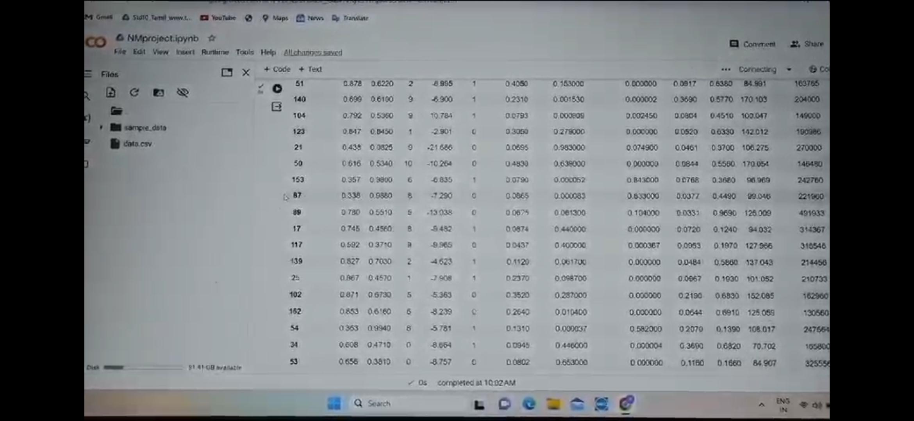
Project Demo(Recorded Video)
https://github.com/Logeshwaran2721/Spotify-music_-recommendation-system-/blob/1c9b8716fd9ae24af30a399fa3b91552264f84d0/Spotifyprojectvideo.mp4

Slide 8
Conclusion
The Spotify Music Recommendation System is a powerful tool that enhances user experience by providing personalized music recommendations tailored to individual preferences. Through advanced algorithms and machine learning techniques, Spotify analyzes user behavior, such as listening history, likes, and dislikes, to curate playlists and suggest songs that align with each user's taste.

Slide 9
Future Scope
The future scope for Spotify s music recommendation system lies in several directions, driven by advancements in technology, data analytics, and user experience. Here are some potential avenues for development:Personalization through Al: Spotify can further enhance its recommendation system by leveraging advanced Al and machine learning techniques. This could involve more sophisticated algorithms that analyze user behavior, preferences, mood, context, and even physiological responses to music, providing highly tailored recommendations.

Slide 10
References
1. Project Github link , Ramar Bose , 2024
2. Project video recorded link (youtube / github), Ramar Bose , 2024
3. Project PPT & Report , Ramar Bose , 2024

Slide 11
THANK YOU

